Slide 1
Data Structures and Algorithms -3 (25CS2103E)
Plagarisim Detection in Research Papers
Team Members
Name: 2520030271 – Raghava Akkinepally
2520030060-JANUMPALLY HANSIKA
2520030212-N.RISHIKA CHOWDARY
Under the Esteemed Guidance of
Dr S. Madhavi Mam CSE department

Slide 2
Abstract
PaperCheck is a plagiarism detection system designed to identify similarities between an uploaded research paper and a dataset of reference research papers. The system extracts text from the uploaded PDF, preprocesses the content, and divides it into K-grams. Rolling Hash is used to generate hash values for these text sequences, while the Rabin-Karp algorithm efficiently compares the hash values to identify matching content. The system calculates the similarity percentage and provides a ranked list of matching reference papers. This project demonstrates the practical application of Data Structures and Algorithms to solve the problem of efficient plagiarism detection.

Slide 3
Introduction
Plagiarism is the use of existing content without proper originality or acknowledgment.
Manually checking large research papers is time-consuming.
PaperCheck provides an automated approach to identify similar content.
The user uploads a research paper in PDF format.
The system extracts and preprocesses the text.
Rolling Hash generates hash values for text sequences.
Rabin-Karp is used to efficiently identify matching sequences.
The final result shows the similarity between the uploaded paper and reference papers.

Slide 4
Literature Survey
Existing Approach | Limitation
Manual plagiarism checking | Time-consuming
Keyword-based matching | May miss similar sentences
Direct text comparison | Expensive for large documents
Traditional string matching | Repeated comparisons can be inefficient
Hash-based matching | Faster comparison using hash values

Slide 5
Problem Statement and Objectives
Problem Statement
To develop a plagiarism detection system that efficiently compares an uploaded research paper with a collection of reference papers using Rolling Hash and Rabin-Karp algorithms.
Objectives
Accept research papers in PDF format.
Extract text from uploaded papers.
Preprocess the extracted text.
Divide text into K-grams.
Generate hash values using Rolling Hash.
Detect matching sequences using Rabin-Karp.
Calculate similarity percentage.
Display matching reference papers and ranked results.

Slide 6
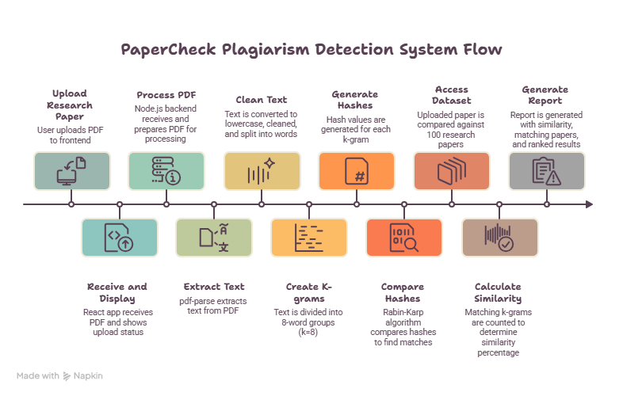
Flow Chart

Slide 7
Results
Expected Results
The system displays:
Uploaded paper name
Number of words extracted
Number of reference papers analyzed
Matching reference papers
Number of matching K-grams
Similarity percentage
Ranked list of similar papers
Example:
Uploaded Paper: ResearchPaper.pdf
Reference Papers: 100
K-Gram Size: 8
Algorithm: Rolling Hash + Rabin-Karp
Similarity: 32.45%

Slide 8
Hardware and Software requirements
Hardware Requirements
Computer/Laptop
Minimum 4 GB RAM
Minimum 10 GB available storage
Internet connection for development/deployment
Software Requirements
Operating System: Windows/Linux
Frontend: React.js + Vite
Backend: Node.js + Express.js
Language: JavaScript
PDF Processing: pdf-parse
File Upload: Multer
Algorithms: Rolling Hash + Rabin-Karp
Dataset: Research Paper PDFs
Editor: Visual Studio Code

Slide 9
Conclusion
PaperCheck provides an automated approach for plagiarism detection.
The system processes research papers and compares their textual content.
Rolling Hash efficiently generates hash values for K-grams.
Rabin-Karp identifies matching sequences using these hash values.
The system generates similarity percentages and ranked matching papers.
The project demonstrates how DSA concepts can be applied to a real-world problem.

Slide 10
Future Scope
Increase the dataset from 100 papers to thousands of papers.
Add support for DOC/DOCX files.
Add OCR for scanned research papers.
Highlight the exact matching passages.
Generate downloadable plagiarism reports.
Add multiple similarity detection techniques.
Improve processing speed for large datasets.
Add a web-based cloud deployment.

Slide 11
Thank you

